Slide 1
Job Builder
p.Vachala
19001206

Slide 2
INTRODUCTION
Job Builder will provide a online job listings website.
Job Builder is not just about job listings ,Job builder is your ultimate destination for discovering and selecting the perfect job to fuel your educational growth.
Our platform offers valuable insights and job lists to explore different majors, career paths.

Slide 3
Flow chart
App component
Admin
Login
Services
Shared
Models
User
Log services
Types
Home
Product
grid
Add product
Home
Pipe
User home
Menu-outline
Product services

Slide 4
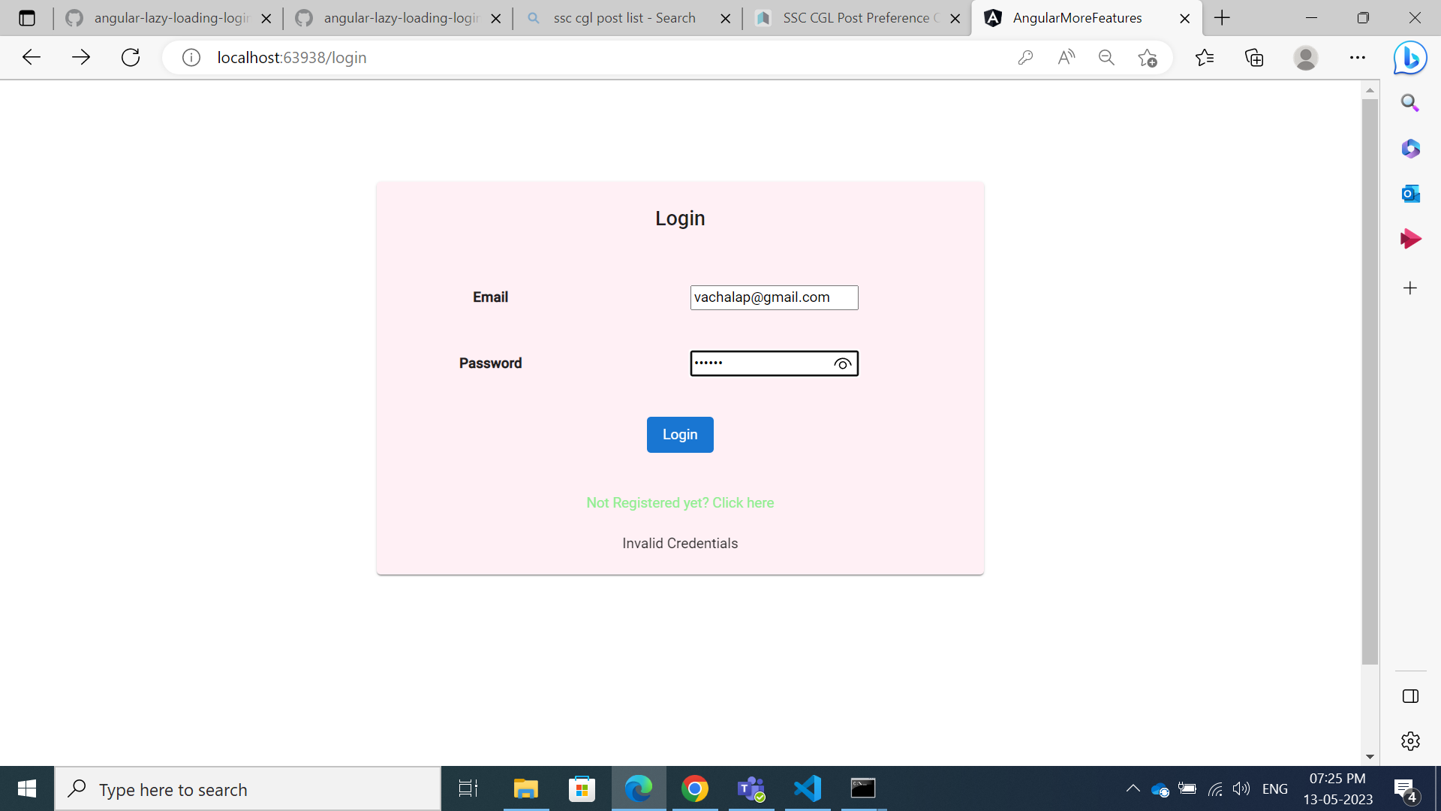

Slide 5
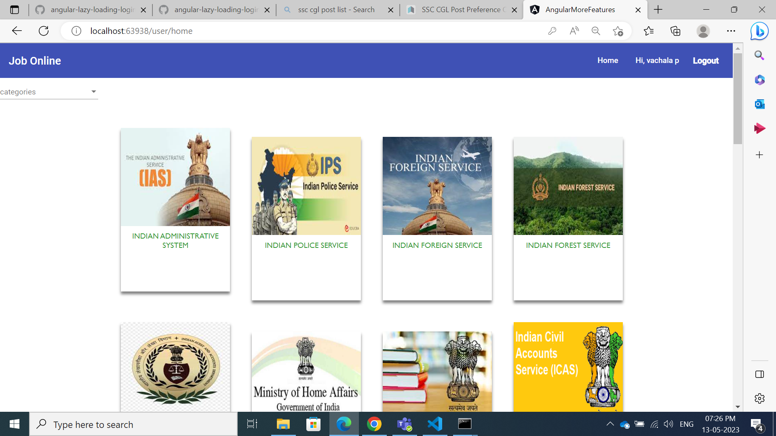

Slide 6


Slide 7
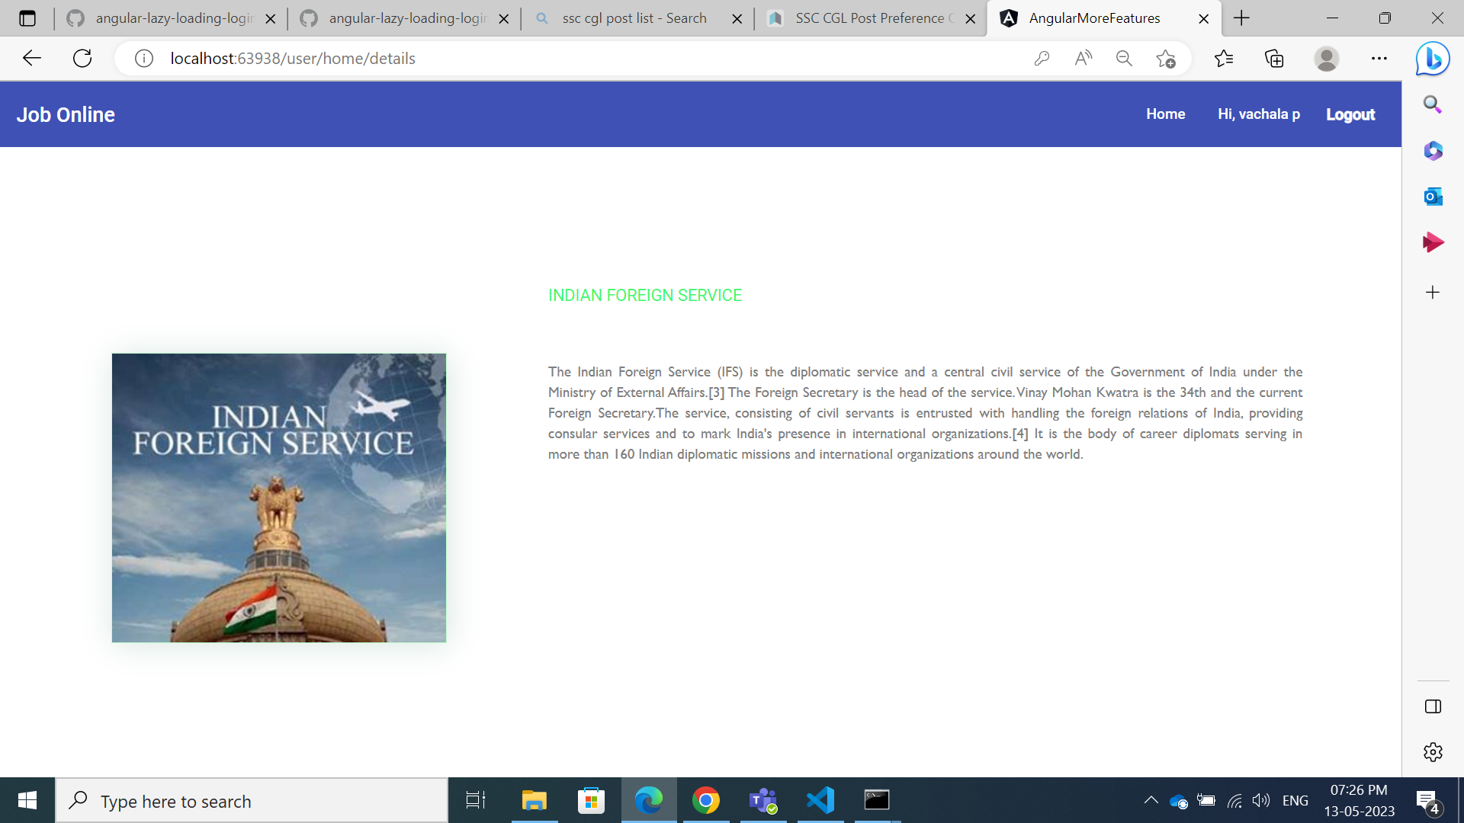

Slide 8
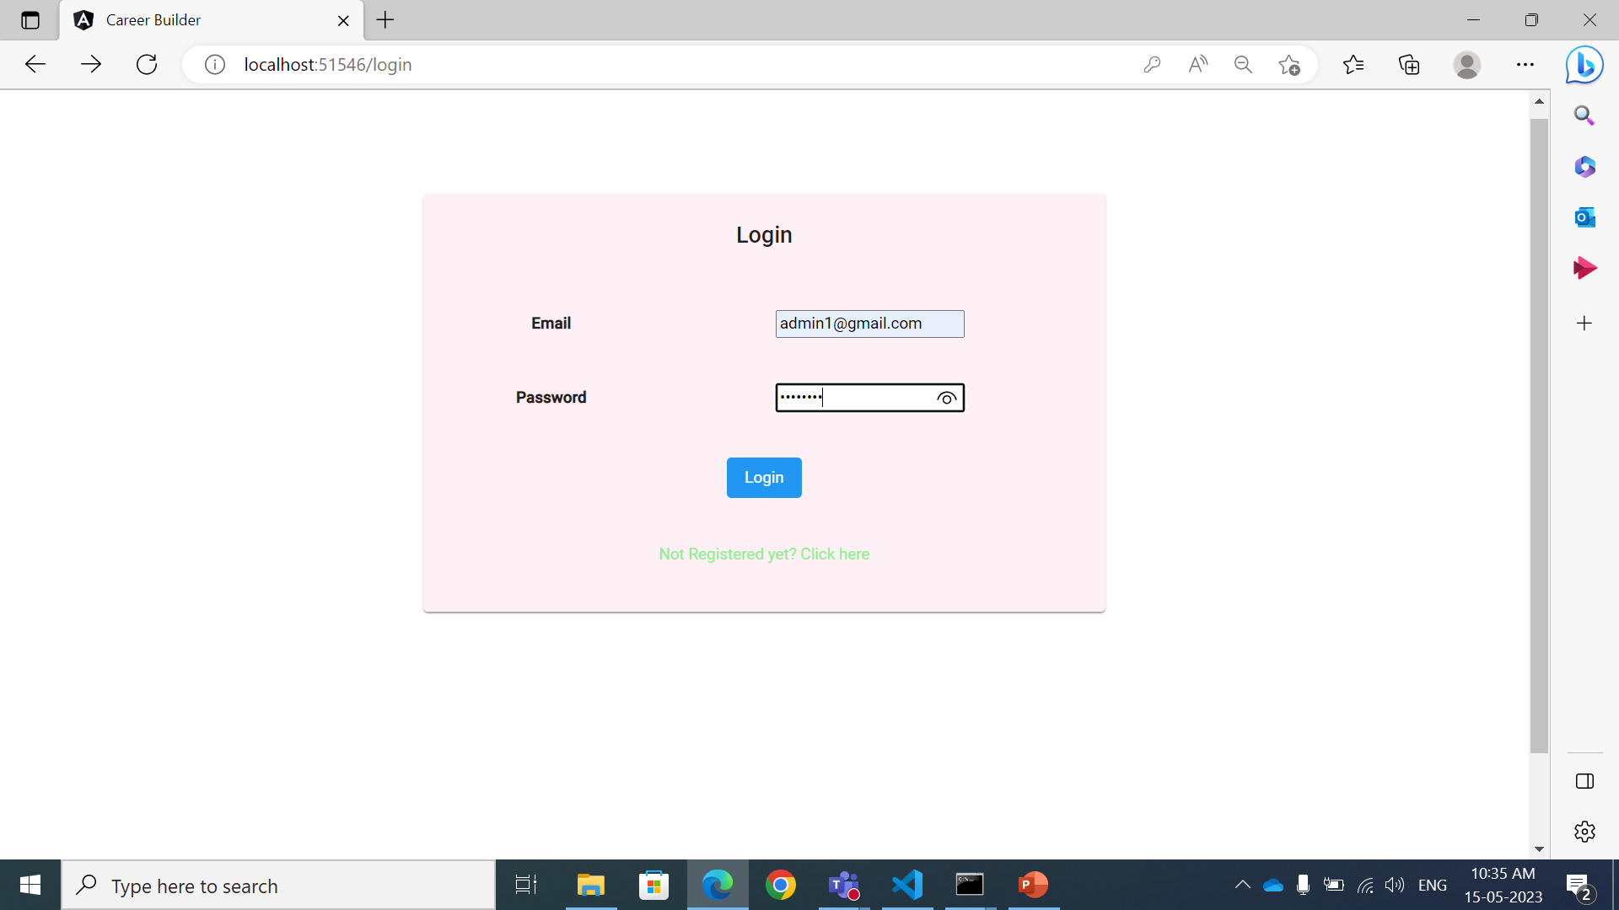

Slide 9
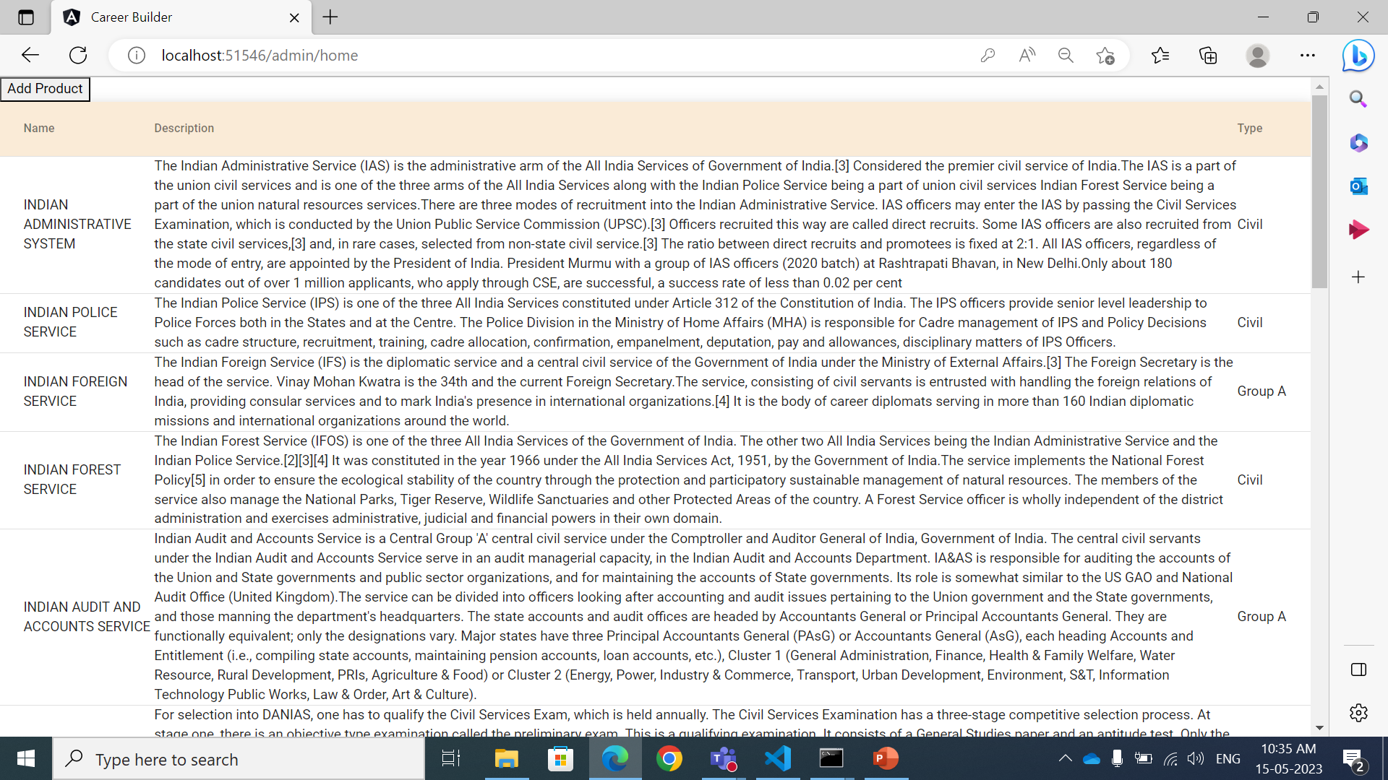

Slide 10
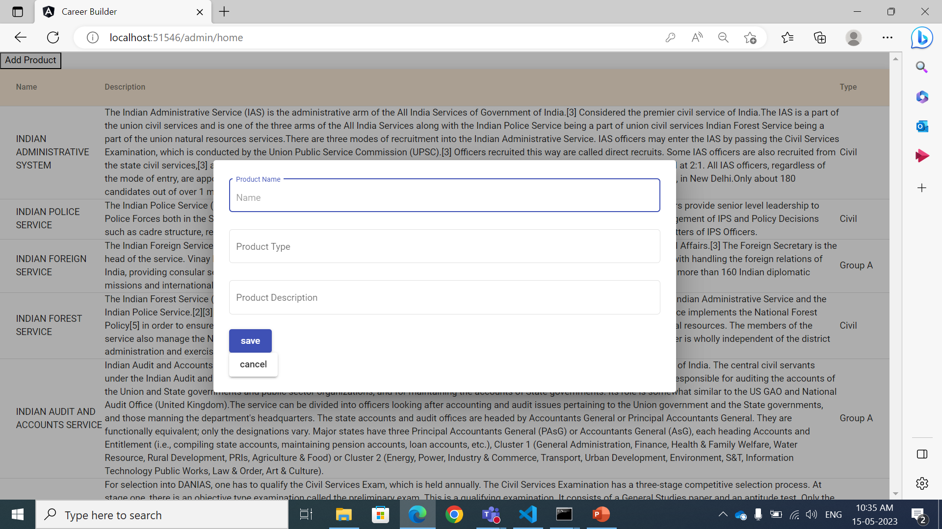

Slide 11
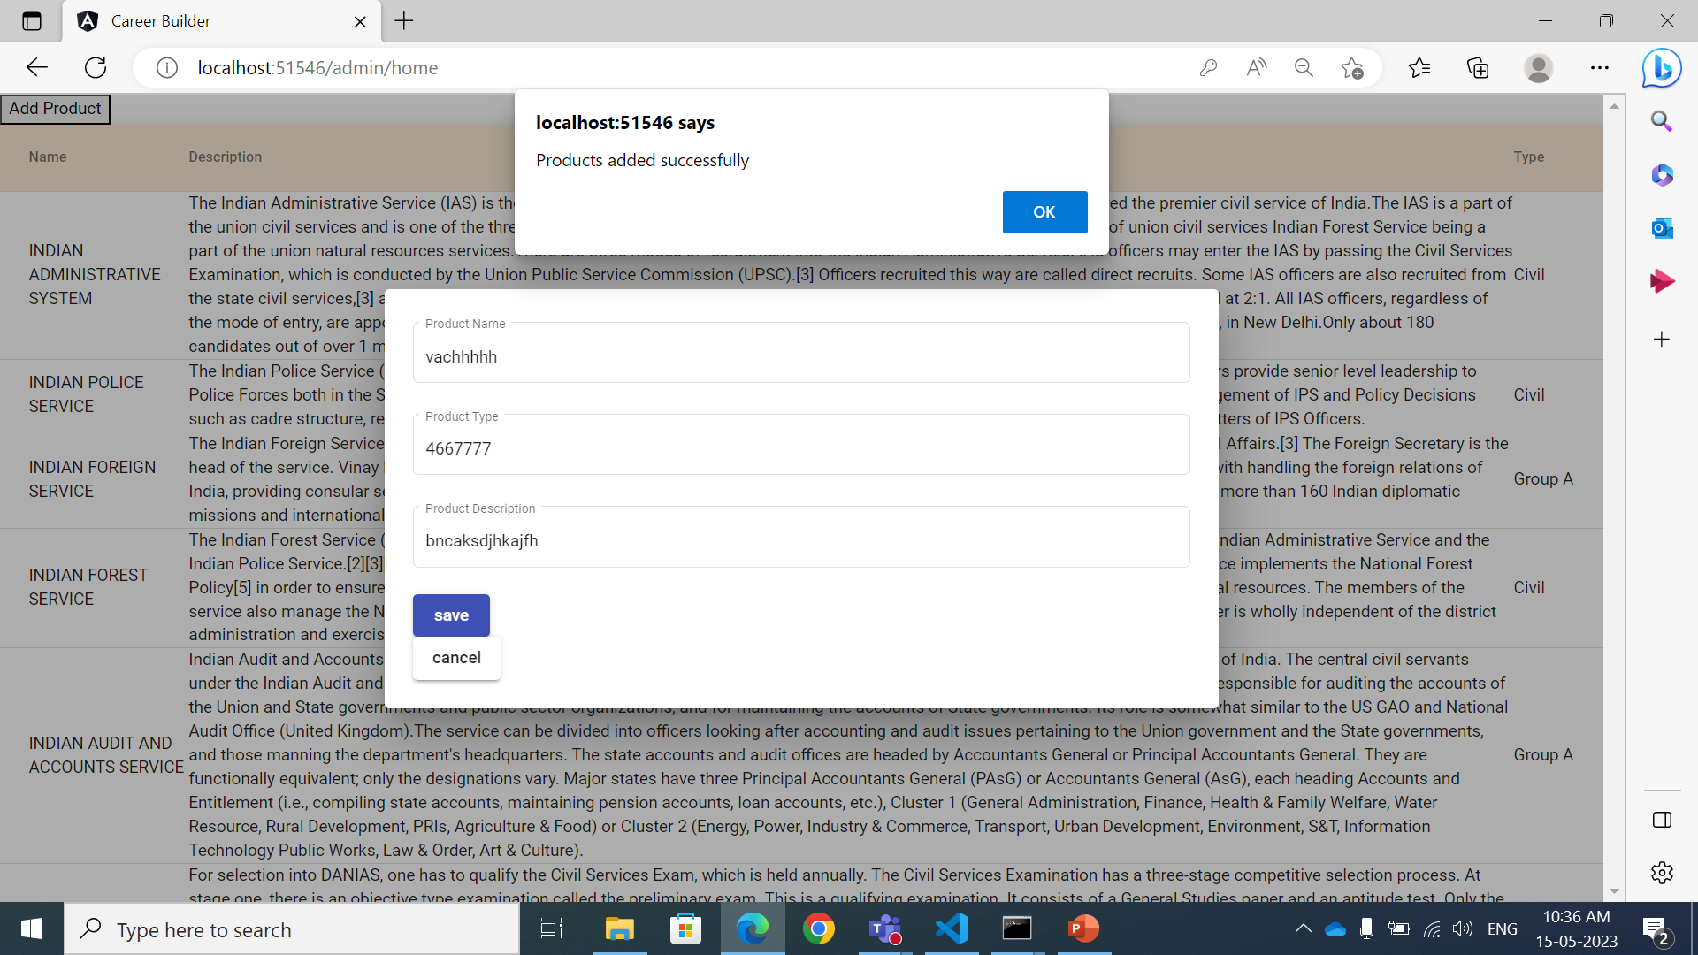

Slide 12
THANK YOU

